Slide 1
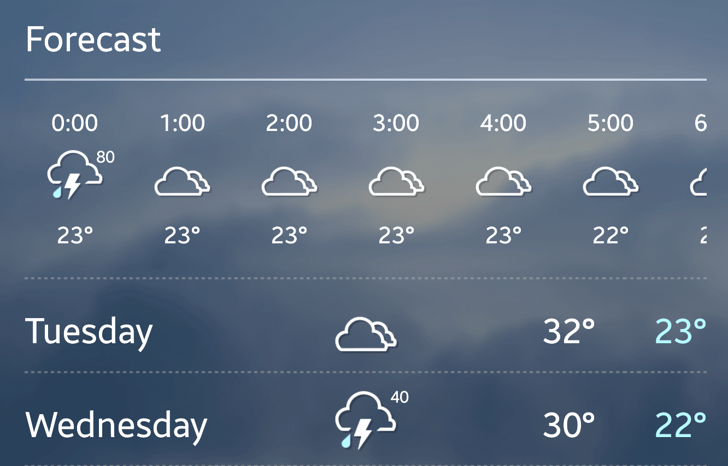

WEATHER FORECASTING USING MACHINE LEARNING (GROUP A)
PRESENTATION BY:
• JEFFIN JOHN ABRAHAM
• SAFNA MOHAMMED FAYAS
• NITHISH JANAGAM
• SHABDA KAFLE
JULY 13, 2024

Slide 2
AGENDA
Dashboarding
Coding Review
Debugging/Stress Testing

Slide 3
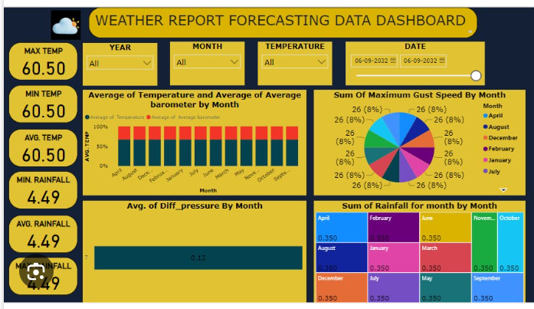
DASHBOARDING
Intuitiveness
Balance of detailedness
Interactivity
Suitability
Accessibility
Responsiveness

Slide 4
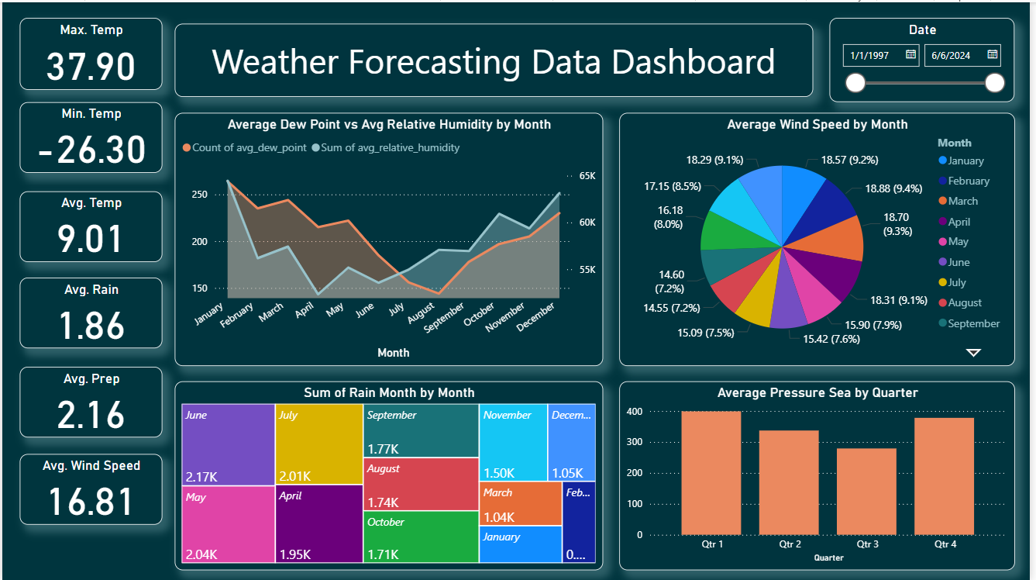
DASHBOARDING
Ease-of-Use and Intuitiveness
Our dashboard is designed with user-friendliness in mind, featuring intuitive navigation and clear visualizations that allow users to easily interpret the data.
Interactivity:
Using Power BI, we have created an interactive dashboard that allows users to drill down into specific data points, filter views, and engage with the data dynamically.

Slide 5
DASHBOARDING
Balance of Detailedness and Completeness:
The dashboard provides a comprehensive view of the data without overwhelming the user, balancing detailed information with overall completeness.
Suitability:
The dashboard is tailored to meet the needs of various stakeholders, from analysts to decision-makers, ensuring that it serves multiple audiences effectively.
Addresses Multiple Audiences:
Our dashboard is designed to cater to different user groups, providing relevant insights for each audience segment.

Slide 6
DASHBOARDING
Accessibility:
The dashboard is accessible across various devices and screen sizes, ensuring that users can access and interact with the data anytime, anywhere.
Responsiveness:
Responsive design principles have been applied to ensure that visualizations automatically adapt their size and layout for optimal viewing on different devices.
Feedback Mechanism:
Feedback mechanisms are in place to continuously improve the dashboard, allowing us to adapt and enhance its features based on user input.

Slide 7
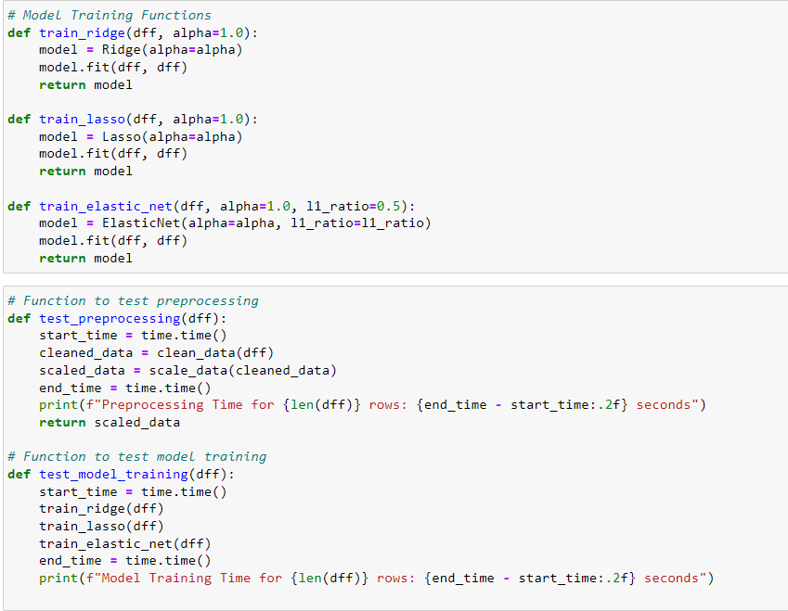
CODE REVIEW
How the code works
Version Control
Live Data Used
Modular Functioning & Efficiency
Latency Testing and Consistency
Adaptability & Extendibility
Scalability with Appropriate parameters
Collaboration

Slide 8
CODE REVIEW
How the code works:
Preprocessing:
Data cleaning, feature engineering, and scaling were performed to prepare the dataset. Outliers were removed, and features were transformed for optimization.
Model Training:
We implemented and compared Ridge Regression, Lasso Regression, and ElasticNet Regression models. Ridge Regression performed the best with 90% accuracy.
Time-Series Cross-Validation:
This technique was used to evaluate model performance over time, ensuring robust predictions.

Slide 9
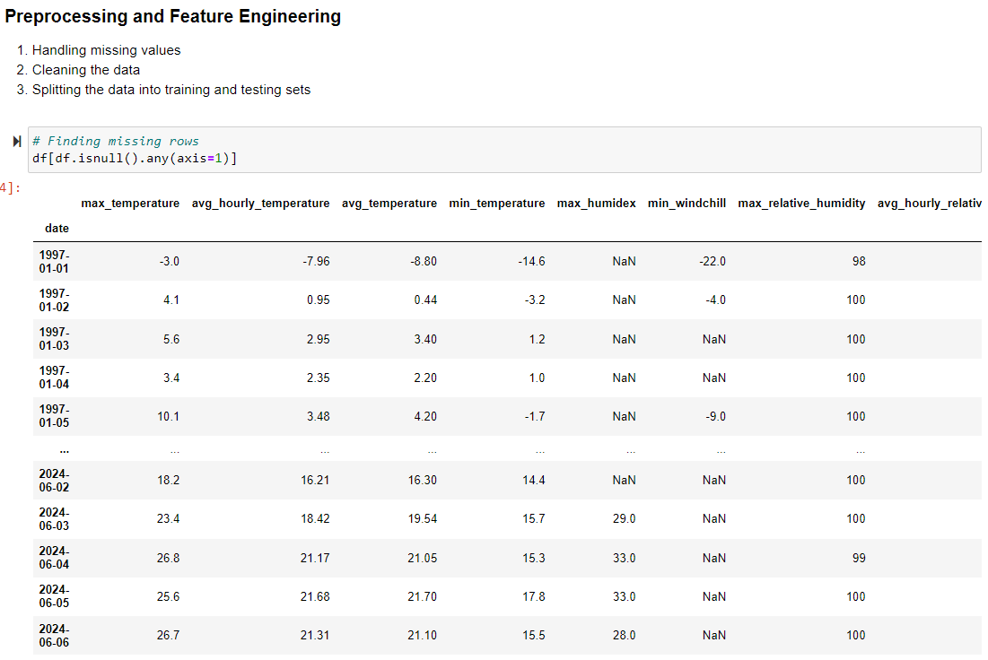
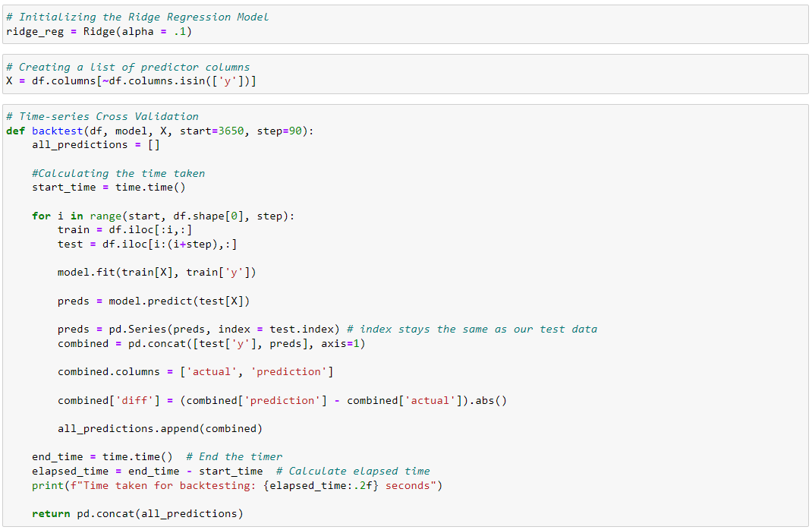
CODE REVIEW
How the code works:

Slide 10
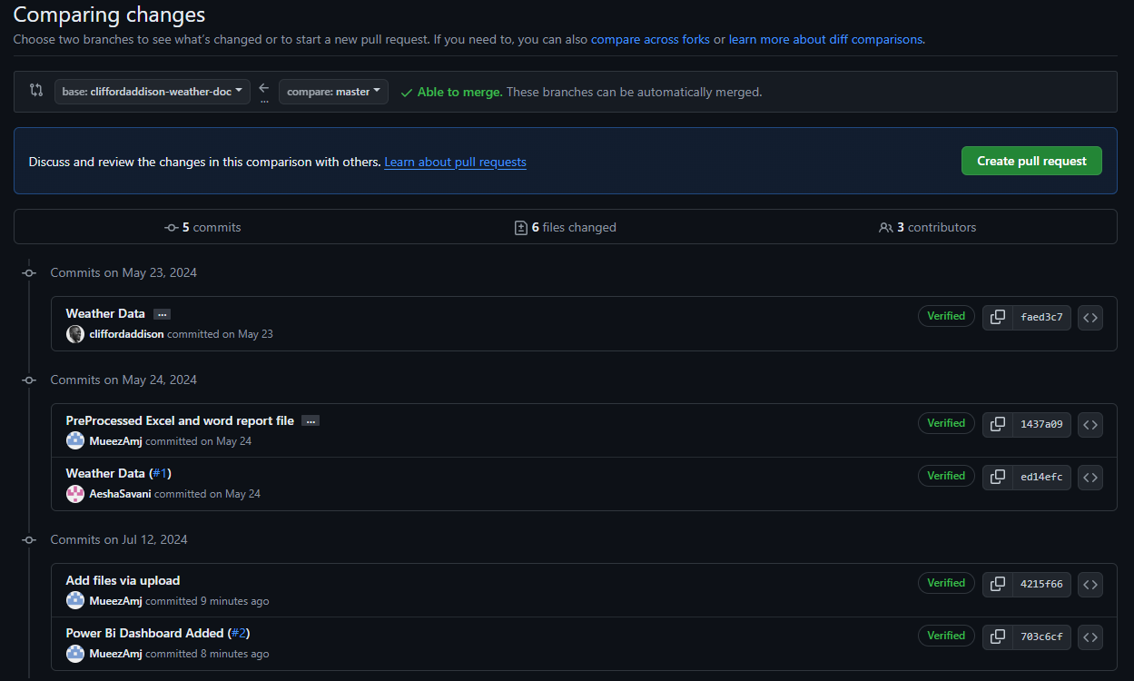
CODE REVIEW
Version Changes:
GitHub: Version control was managed using GitHub, with regular updates reflecting preprocessing, model application, and optimization stages.

Slide 11
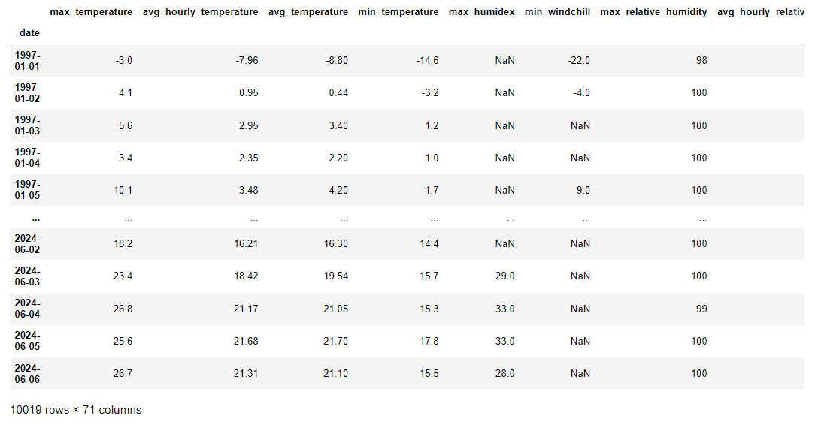
CODE REVIEW
Use of Live Data:
Real-Time Data Acquisition: Data from 1996 to 2024 was used, containing 71 unique features with over 10,000 data points each.
Data Processing and Model Training: Live data was processed and used for continuous model training and deployment.

Slide 12
CODE REVIEW
Modular Functioning:
Data Preparation, Model Initialization, Backtesting, Performance Evaluation: The code was modularized for clarity and reusability.
Efficient Structure:
Streamlined Preprocessing and Feature Engineering: Ensuring clean input data.
Optimized Hyperparameters: Balancing bias-variance trade-offs.
Scalability: Designed to handle large datasets efficiently.
Consistency:
Uniform Performance: Maintaining consistent results across different code sections.

Slide 13
CODE REVIEW
Easy to Adapt and Extendable:
Parameterization: Allows customization and fine-tuning for various scenarios.
Extendable Design: Facilitates adding new features and functionalities.

Slide 14
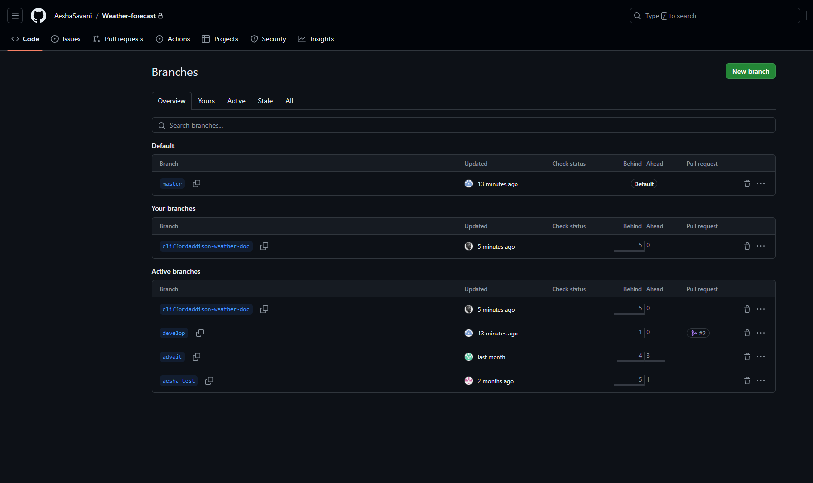
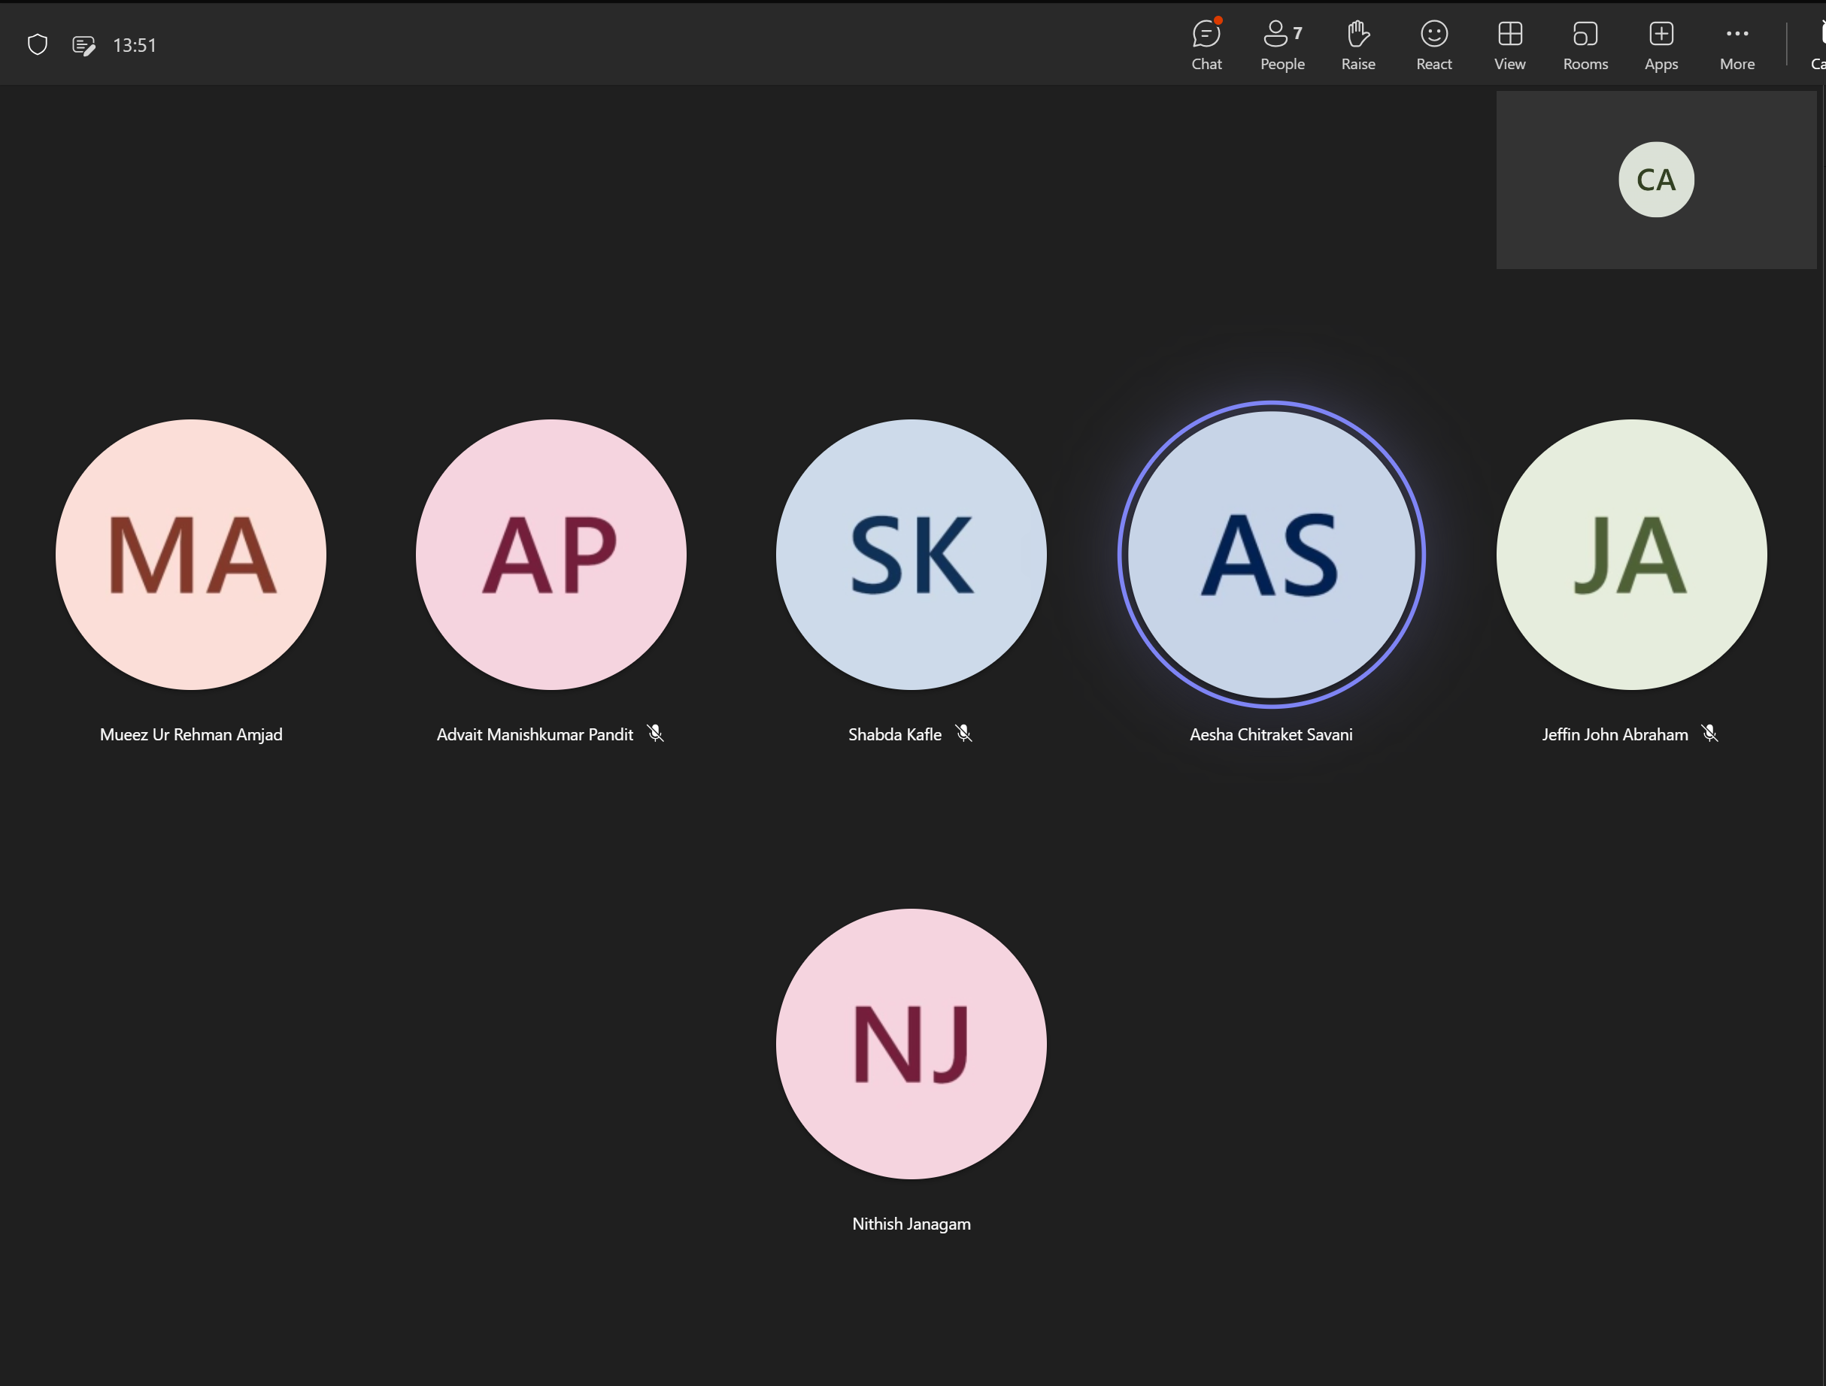
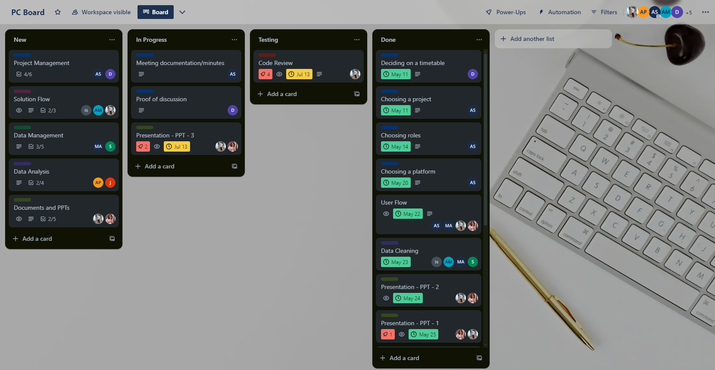
CODE REVIEW
Collaboration:
Tools Used: Google Colab/Jupyter Notebook, GitHub, Trello, Microsoft Teams for efficient teamwork and feedback management.

Slide 15
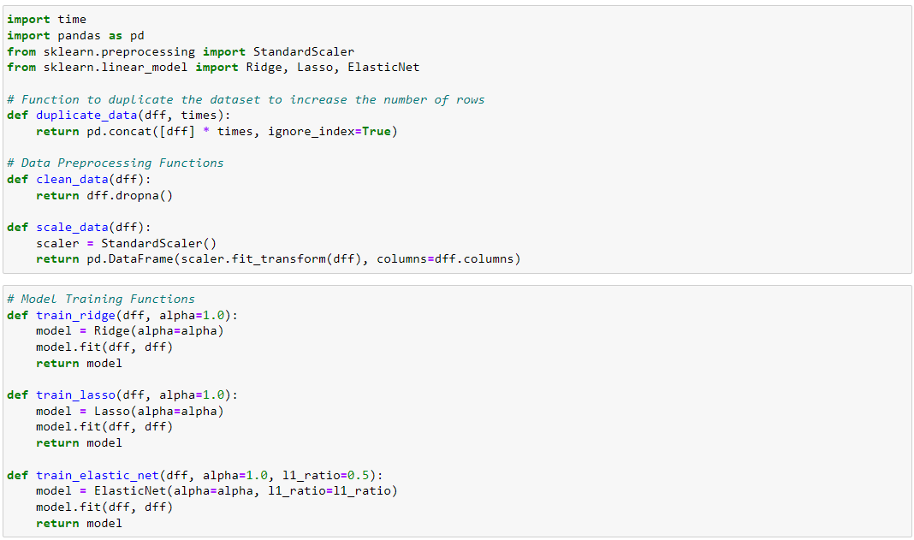
DEBUGGING & STRESS-TESTING
Unit Testing
Corner Case Testing
Scalability Testing
Load Testing
Latency Testing

Slide 16
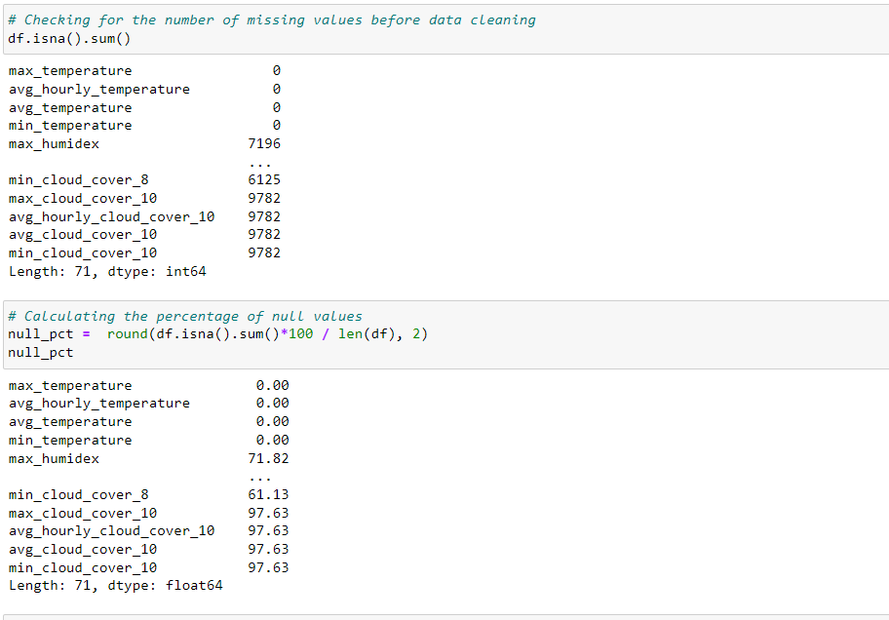
DEBUGGING & STRESS-TESTING
Unit Testing:
Individual Module Testing: Ensuring each code block functions correctly.
Data Cleaning Functions: Specifically tested for handling missing values.
Extensive Edge/Corner Case Testing:
Extreme Conditions: Tested for unusual conditions like dataset columns with majority missing values.

Slide 17
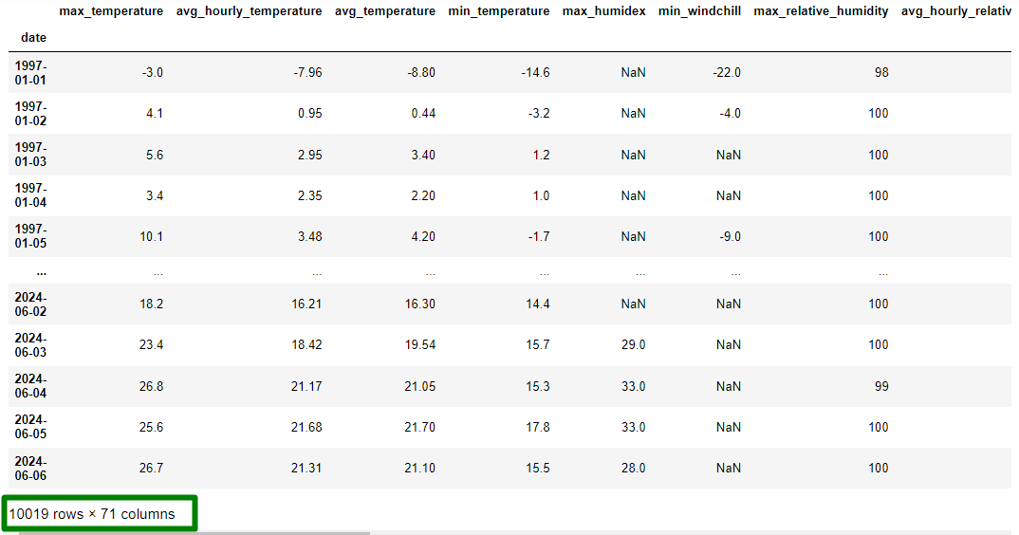
DEBUGGING & STRESS-TESTING
Scalability Testing:
Increased Data Load: Ensuring smooth operation with larger datasets.

Slide 18
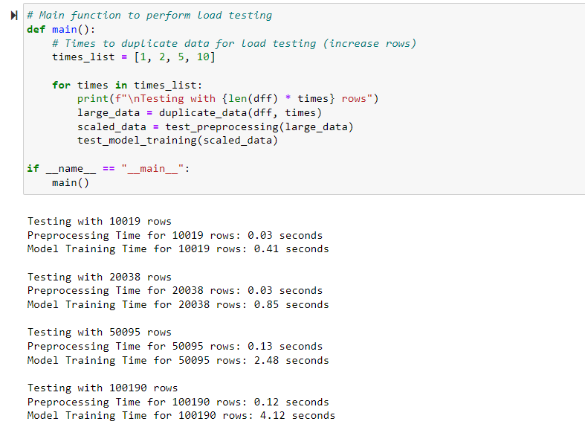
DEBUGGING & STRESS-TESTING
Load Testing:
Model Performance Under Heavy Load: Optimization techniques applied for improved handling.

Slide 19



DEBUGGING & STRESS-TESTING
Speed/Latency Experiments:
Improving Execution Speed: Using parallel processing and vector operations.
Corrected Errors and Engaged Optimizations/Improvements:
Error Detection and Correction: Continuous process to enhance model performance.

Slide 20
Summary
Our project focuses on developing a highly interactive and user-friendly dashboard, performing rigorous coding reviews, and conducting extensive debugging and stress testing to ensure the accuracy and efficiency of our weather forecasting models.

Slide 21
Q & A
We are excited to answer all your questions.

Slide 22
THANK YOU

